Slide 1

Minor Project -2 -23ECSW304
Finger Vein and Finger Knuckle Point Recognition
Team-D2
USN | NAME
01fe21bcs243 | Ankith Chavan
01fe21bcs083 | Srivathsa Acharya
01fe21bcs197 | Mohammed Afnan
01fe21bcs127 | Suraj madar
01fe22bci402 | Om khoday
GUIDED BY:
Prof. Neha T

Slide 2
CONTENTS
Introduction
Motivation
Literature survey
Problem Analysis
Problem Formulation
Objectives

Slide 3
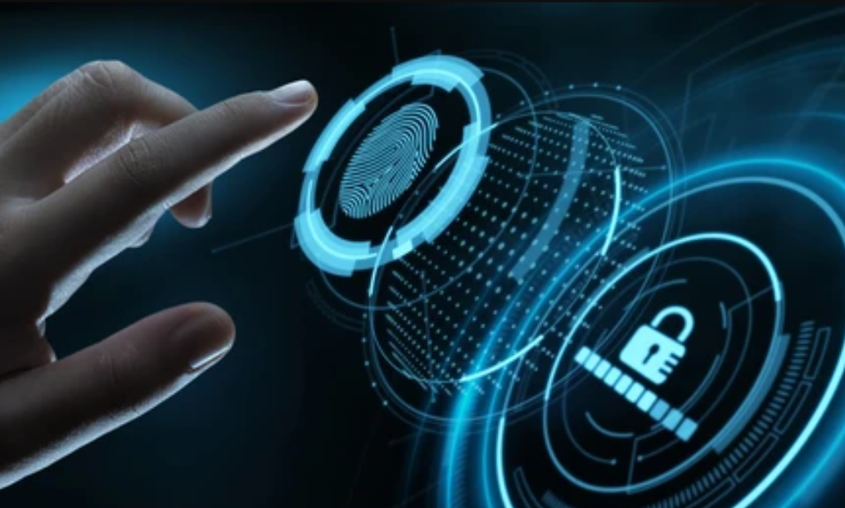
2.Introduction:
In an era prioritizing privacy and security, conventional identification methods fall short.
Human body features, like finger vein and finger knuckle patterns, offer unique identifiers.
These biometric modalities are gaining attraction due to their reliability, precision, and resistance to forgery.
Combining finger vein and finger knuckle print recognition enhances security and accuracy.
Deep learning techniques, specifically CNNs, are utilized for feature extraction and classification.
Transfer learning adapts pre-trained models for finger vein and finger knuckle print recognition.
Fusion of these modalities improves overall recognition performance.

Slide 4
3.Motivation:
1.Security Concerns:
i) Rising security concerns and the need for more robust authentication systems.
ii) Increasing incidents of identity theft and fraud.
2.Technological Advancements:
i) Availability of more advanced imaging and processing technologies.
ii) The need for more reliable and secure authentication methods in various domains like banking, healthcare, and access control.
3.Hygiene Concerns:
i) Growing awareness regarding hygiene and the need for non-contact biometric authentication systems.

Slide 5
3.Motivation:
4.Academic and Technological Interest:
i) Exploring the potential of multimodal biometric systems for enhanced security and reliability.
ii) Contribution to the field of biometric authentication and data engineering.

Slide 6
4.Literature Survey:
1. "A Deep Learning-Based Multimodal Recognition Biometric System Using Finger Vein and Finger Knuckle Print," 2023 24th International Arab Conference on Information Technology (ACIT), Ajman, United Arab Emirates, 2023, pp. 1-8, doi: 10.1109/ACIT58888.2023.10453891.
Authors: M. L. Abimouloud, K. Bensid and M. Kherallah
Multimodal Biometric System: The paper introduces a novel multimodal biometric identification system combining finger vein and finger knuckle print modalities using convolutional neural networks (CNNs), specifically leveraging transfer learning with pre-trained models like AlexNet, VGG16, VGG19, and GoogleNet for feature extraction and classification.
Performance Evaluation: Initial evaluations compare the performance of unimodal systems for finger knuckle print (FKP) and finger vein (FV) modalities. The fusion of unimodal scores at the matching score level results in promising performance, with an Equal Error Rate (EER) of 0.000% for the FKP multimodal system and an EER of 0.00599% for the FV multimodal system, demonstrating significant improvement over unimodal approaches.
Advantages : The paper highlights the advantages of multimodal biometric systems, including enhanced accuracy, security, and resilience against issues like non-universality and spoofing attacks. Additionally, a comparative study against previous state-of-the-art methods showcases the competitive performance of the proposed multimodal system.
Summary
The proposed work develops a multimodal biometric identification system that integrates multiple biometric modalities.
The paper presents a comprehensive approach, including data acquisition, preprocessing, feature extraction using deep learning techniques, and score-level fusion for multimodal biometric recognition.
Gap: It primarily focuses on the fusion of finger vein and finger knuckle print modalities, potentially leaving out other biometric modalities or alternative fusion techniques.

Slide 7
4.Literature Survey:
2.Robust and Sparse Least Square Regression for Finger Vein and Finger Knuckle Print Recognition, in IEEE Transactions on Information Forensics and Security, vol. 19, pp. 2709-2719, 2024, doi: 10.1109/TIFS.2024.3352389.
Authors: S. Li, B. Zhang, L. Wu, R. Ma and X. Ning
Unified Framework: RSLSR integrates robust projection learning, noise decomposition, and discriminant sparse representation into a cohesive framework, addressing limitations like reliance on prior information and non-robustness to different modalities.
Direct Learning from Raw Data: By directly learning from raw pixel data without relying on pre-extracted features, RSLSR reduces computational costs and enhances adaptability to various scenarios, achieving superior recognition accuracy across multiple finger databases.
Efficient Optimization: The proposed optimization strategy utilizing ADMM ensures computational efficiency while effectively learning the sparse and discriminative transformation matrix, further contributing to the method's superiority over existing approaches.
Summary
The proposed RSLSR method addresses the limitations of existing methods by providing a robust and adaptable framework for feature extraction and recognition.
The paper presents a comprehensive approach, including noise decomposition, sparse representation, and projection learning.
Gap: While it improves recognition accuracy and robustness, it may not delve into the integration of other biometric modalities or explore alternative regression techniques.

Slide 8
4.Literature Survey:
3. Research on Inner Knuckle Pattern Recognition Method Based on Convolutional Neural Network ,2021 IEEE 5th Advanced Information Technology, Electronic and Automation Control Conference (IAEAC).
Authors: Yanxue Xue,Mengyue Liu,Mengmeng Qiao,Meng Xue
Extracting the region of interest : Proposes a method for personal identification based on inner knuckle patterns using convolutional neural networks (CNNs). The method involves preprocessing the hand image, extracting the region of interest (ROI) containing the inner knuckle pattern, and then using a CNN for feature extraction and classification.
Various parameters : studies the impact of various parameters on the recognition results, such as learning rate, number of convolutional kernels, number of neurons in the fully connected layer, number of convolutional layers, and different optimization algorithms (Mini-batch SGD and Adam).
Performance Evalution: Through experimental analysis on the CASIA-Multi-Spectral-PalmprintV1 database, the authors achieved a recognition rate of 95.2% for inner knuckle pattern recognition using the proposed CNN-based method.
Summary
Presents a hand inner knuckle pattern recognition method using convolutional neural networks. It involves preprocessing steps like binarization, morphological processing, contour extraction, and ROI extraction before feeding the images to the CNN.
Experimented with different parameter settings like learning rate, number of convolutional kernels, neurons in fully connected layer, optimization algorithms etc. and found the optimal settings that gave 95.2% recognition accuracy on the CASIA palmprint database.
Gap: The complexity of the preprocessing pipeline for inner knuckle patterns could be a drawback limiting the wide-scale adoption and deployment of this method in practical applications, especially in resource-constrained or real-time systems.

Slide 9
4.Literature Survey:
4. Finger vein recognition based on Deep Convolutional Neural Networks,2020 13th International Congress on Image and Signal Processing, BioMedical Engineering and Informatics (CISP-BMEI).
Authors:Lecheng Weng ,Xiaoqiang Li ,Wenfeng Wang
Improved convolutional neural network :The paper proposes a finger vein recognition method based on an improved convolutional neural network to improve accuracy and robustness. It involves preprocessing steps like image segmentation, finger root key point location, and region of interest (ROI) extraction.
Adjusted according to application: The convolutional neural network structure is adjusted according to the application context of finger vein recognition. The output of the convolution layer is batch normalized, and the optimized neural network is used for automatic feature extraction, classification, and identification of the preprocessed images.
Optimal recognition rate :Experiments were performed on the public finger vein dataset from Shandong University. The proposed method achieved an optimal recognition rate of 90%, verifying its effectiveness.
Summary
Preprocessing the collected finger vein images through segmentation, locating the finger root keypoint, and extracting the region of interest (ROI).
Using the optimized DCNN to automatically extract features from the preprocessed images and perform classification/identification.
Gap: The key gap or drawback highlighted in this paper is the limited availability of large finger vein image datasets to effectively train deep convolutional neural networks.

Slide 10
4.Literature Survey:
5. A Survey of Finger Vein Recognition,
9th International Conference on Orange Technology (ICOT) in 2021.
Authors: Nghi C. Tran,Jia-Ching Wang
Finger vein recognition systems :It provides an overview of finger vein recognition systems, which use the unique vein pattern in a person's finger as a biometric identifier. Finger vein recognition is considered more secure and hygienic compared to other biometric traits like fingerprints or facial recognition.
Compares advantages: classifies finger vein recognition approaches into two categories: conventional methods based on handcrafted features like maximum curvature, mean curvature, minutiae, etc., and deep learning methods like convolutional neural networks (CNNs). It discusses the advantages of deep learning approaches, which have shown better performance, especially with low-quality or varying finger vein images.
Lists datasets : lists several publicly available finger vein datasets like SDUMLA, HKPU-FV, MMCBNU_6000, UTFV, FV-USM, and THUFV2, which can be used for research and evaluation of finger vein recognition algorithms. It also summarizes the current state-of-the-art performance on these datasets using different conventional and deep learning approaches.
Summary
It surveys different approaches for finger vein recognition, contrasting conventional handcrafted feature methods versus newer deep learning CNN-based methods which have shown better performance on public datasets.
It overviews several publicly available finger vein image datasets and summarizes the state-of-the-art recognition performance results on these datasets reported by various recent papers.
Gap: The number of publicly available finger vein datasets is limited, and the amount of sample images in these datasets is insufficient, making it difficult to further improve the performance of deep learning models for finger vein recognition.

Slide 11
5. Problem Formulation
To design a multimodal biometric identification system that leverages a combination of finger vein recognition and finger knuckle print recognition for enhanced security and accuracy.

Slide 12
6. Objectives
To collect the image dataset of finger veins and knuckle prints.
To preprocess the fingerprint and finger knuckle images
To extract features from the preprocessed finger vein and knuckle print images like vein pattern and knuckle point.
To explore feature-level fusion techniques to combine complementary information from both modalities effectively.
To design and implement deep learning architectures suitable, leveraging techniques such as convolutional neural networks.

Slide 13
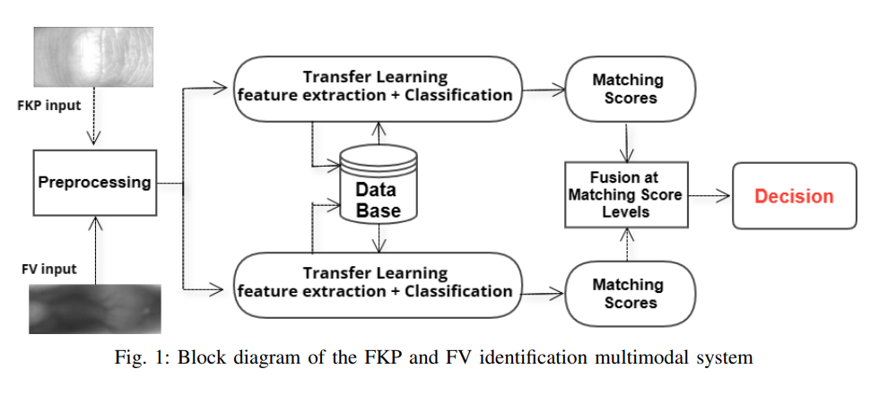
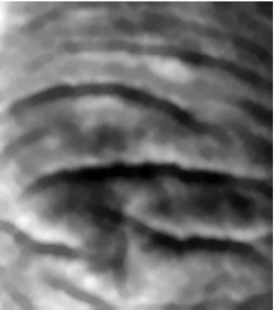

System Design:
FKP - Finger Knuckle point
FV – Finger Vein
CNN model
Multiple feature extraction models
Multiple model feature extraction (Knuckle)
Matching Scores
GenAI for Knuckle Matching
FKP data Preprocessing
Fusion at matching score level
Decision
FV data Preprocessing
Multiple model feature extraction (Vein)
Matching Scores
GenAI for Vein Matching
CNN model
Multiple feature extraction models
Unimodal system

Slide 14
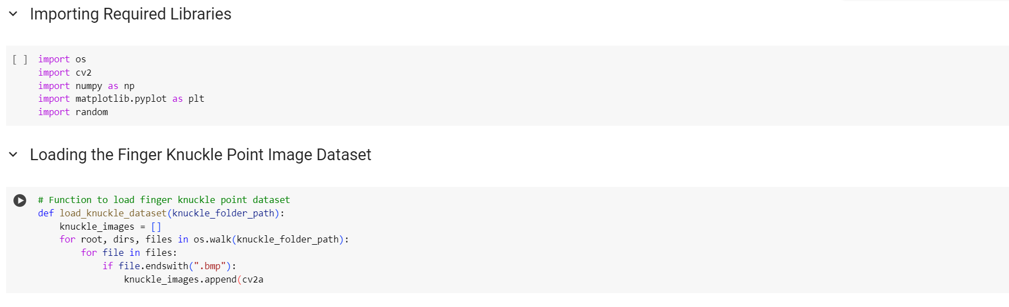
Implementation of the module:

Slide 15
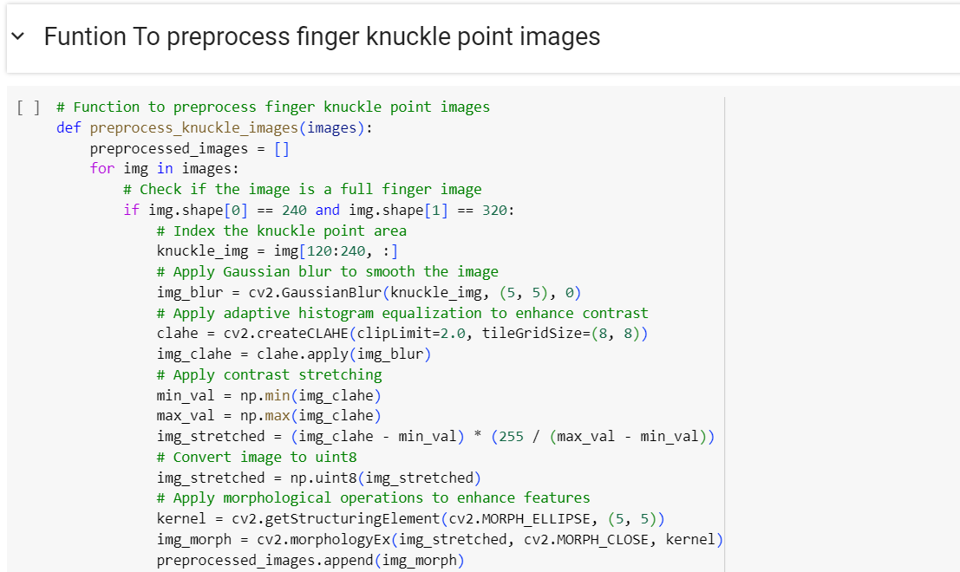
Implementation of the module:

Slide 16
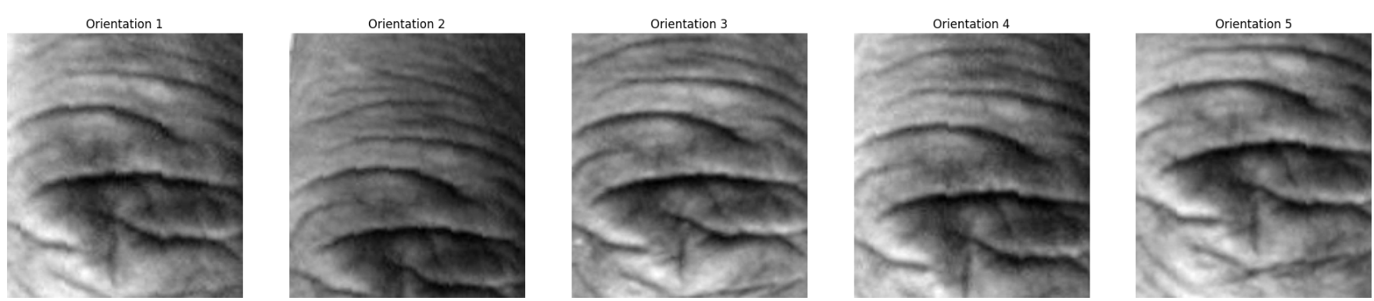
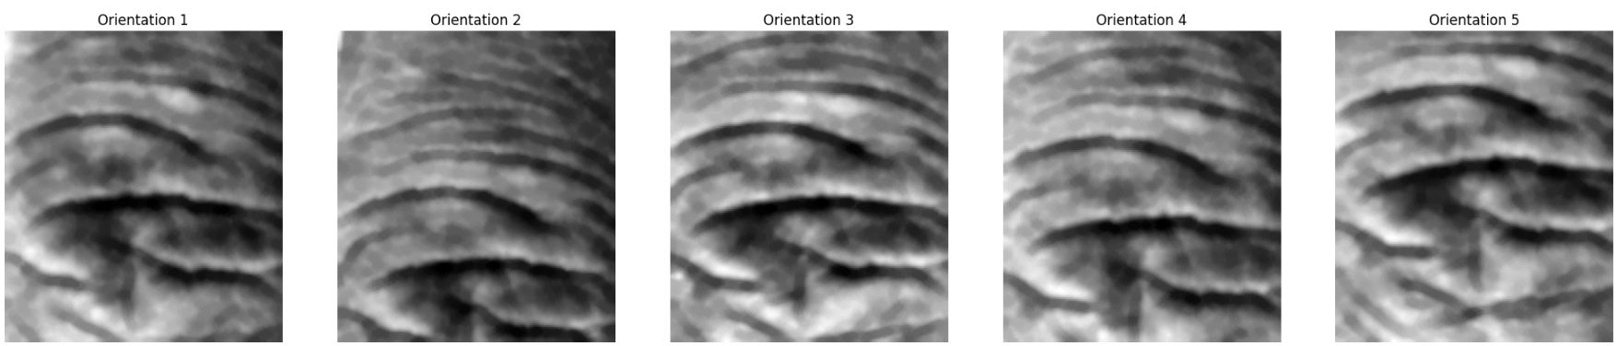
Module Testing and intermediate result:
Sample finger Knuckle Point Images
Pre-processed finger Knuckle Point Images

Slide 17
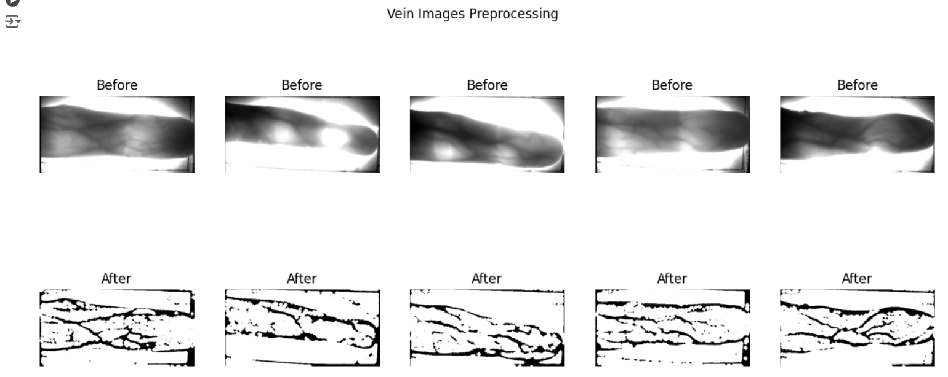
Module Testing and intermediate result:

Slide 18
Thank You

